Slide 1
Water Tracker App
By Faron Young

Slide 2
Water Tracker Scope
The water tracker app allows a user to track their intake of water, to motivate and record their water consumption and compare their intake with their hydration goals

Slide 3
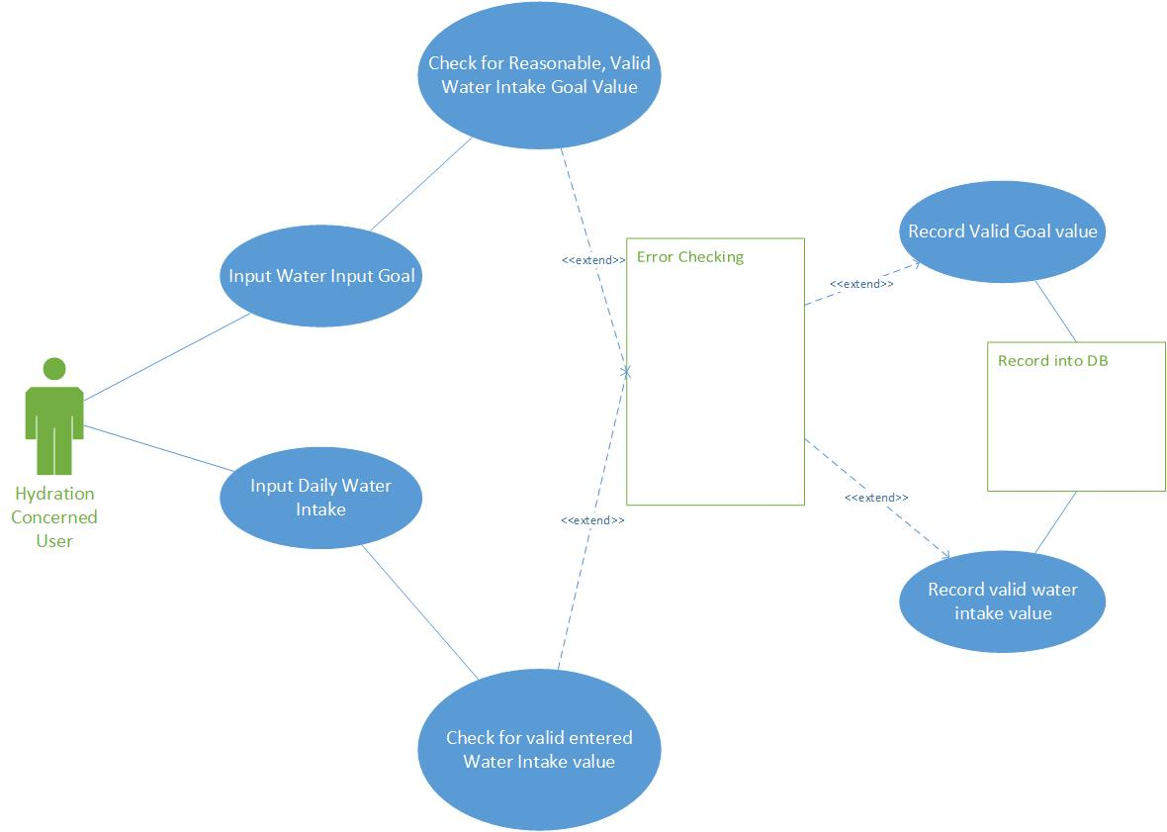
Use Case Diagram

Slide 4
Use Case Document
Title: | Water Tracker
Description: | The water tracker app allows a user to track their intake of water, to motivate and record their water consumption and compare their intake with their hydration goals
Primary Actor: | Hydration Concerned User
Pre-conditions: | None
Post-conditions: | Water Goal input value, Water intake value
Main Succes Scenario: | User inputs a valid goal value, then inputs valid intake value and values are recorded in DB for reporting
Extensions: | 3 Error Scenarios Goal Value invalid, or unreasonable Intake value invalid, or unreasonable Intake value entered before goal value
Frequency: | Multiple times daily
Status: | Beta
Owner: | Faron Young
Priority: | High

